Slide 1
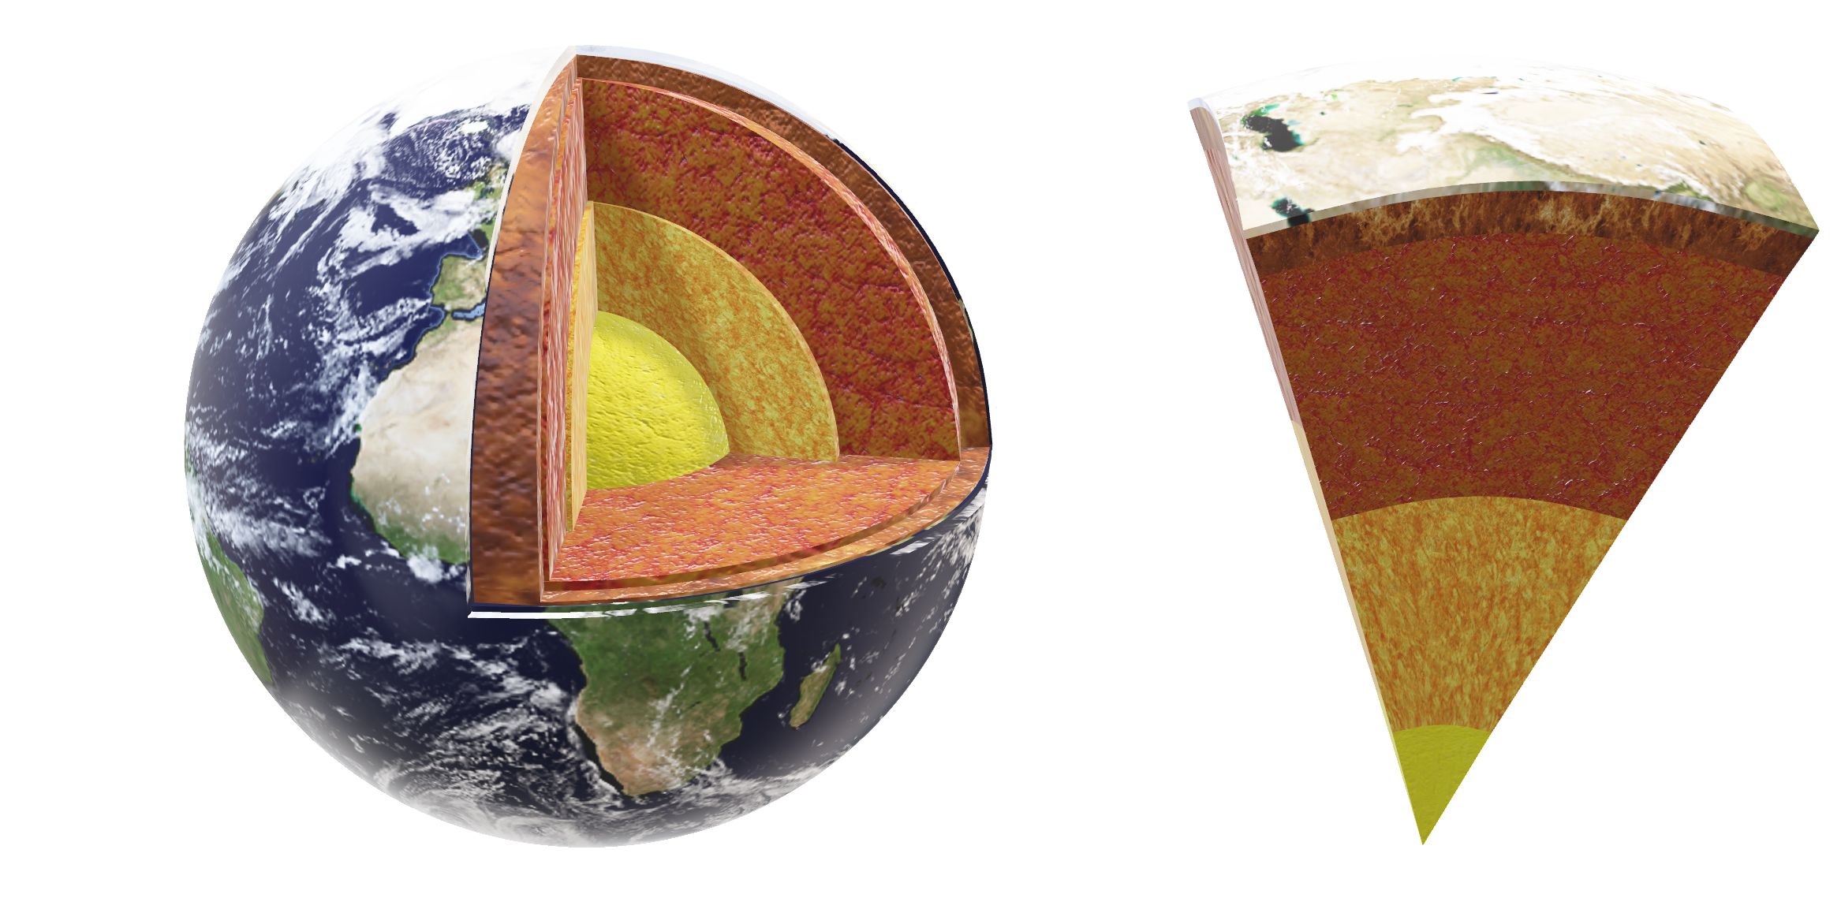

Slide 2
(lat₂,long₂)
A
90º
⍬
C (0,0)
r=3,958.8 mi
B
(lat₁,long₁)
d=2r⋅arcsin(sin²(2latitude₂​−latitude₁​​)+cos(latitude₁​)⋅cos(latitude₂​)⋅sin²(2longitude₂​−longitude₁​​)
d = Distance between two points (in miles)
r = Earth's radius (3,959 miles)
latitude₁​, latitude₂ = Latitudes of the two points (in radians)
longitude₁​, longitude₂​ = Longitudes of the two points (in radians)

Slide 3
A
Opposite
Hypotenuse
90º
⍬
B
Adjacent
C
Function | Ratio | Reciprocal
Sin (θ) | = opposite / hypotenuse | csc(θ) =1/Sine(θ)
Cos(θ) | = adjacent / hypotenuse | sec(θ) =1/Cos (θ)
Tan (θ) | = opposite / adjacent | cot(θ) =1/Tan (θ)

